Slide 1

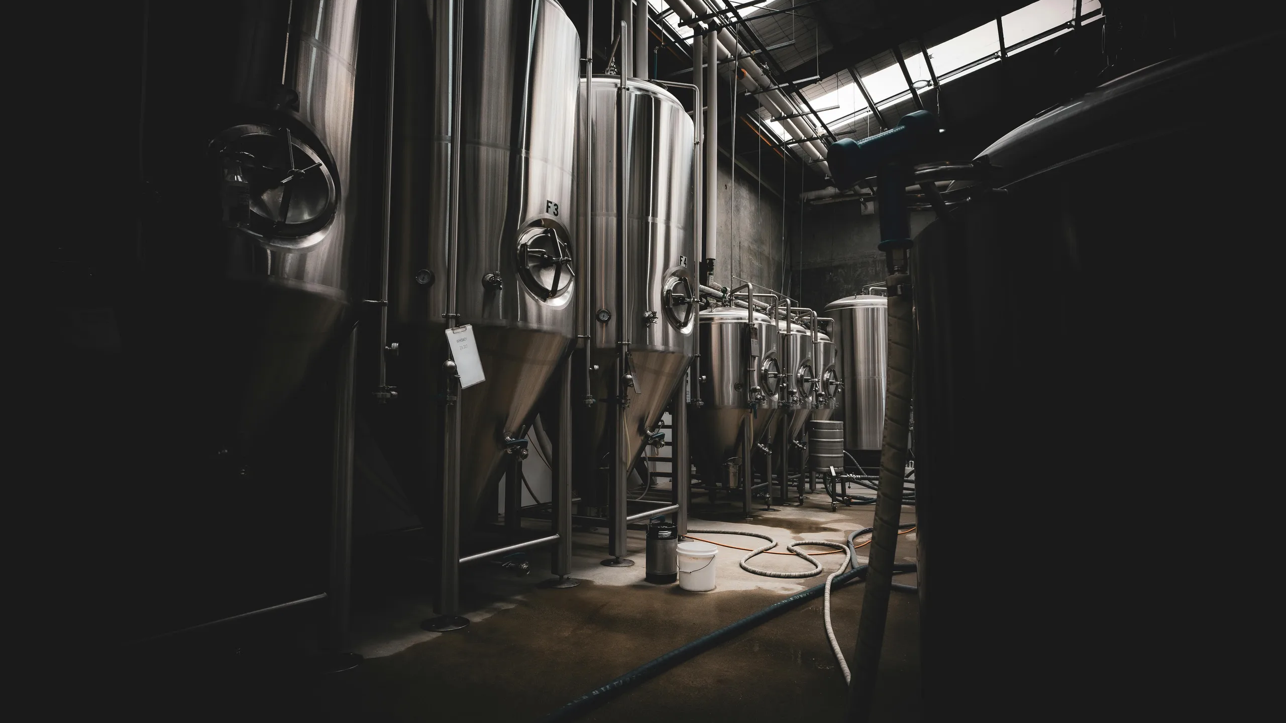
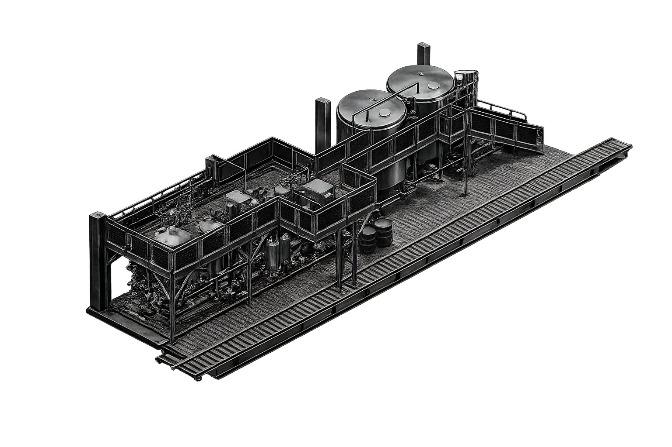

PREMIUM PULP PASTEURIZER
Advanced Solutions for Premium Pulp Processing
Engineering High-Performance Process Solutions

Slide 2
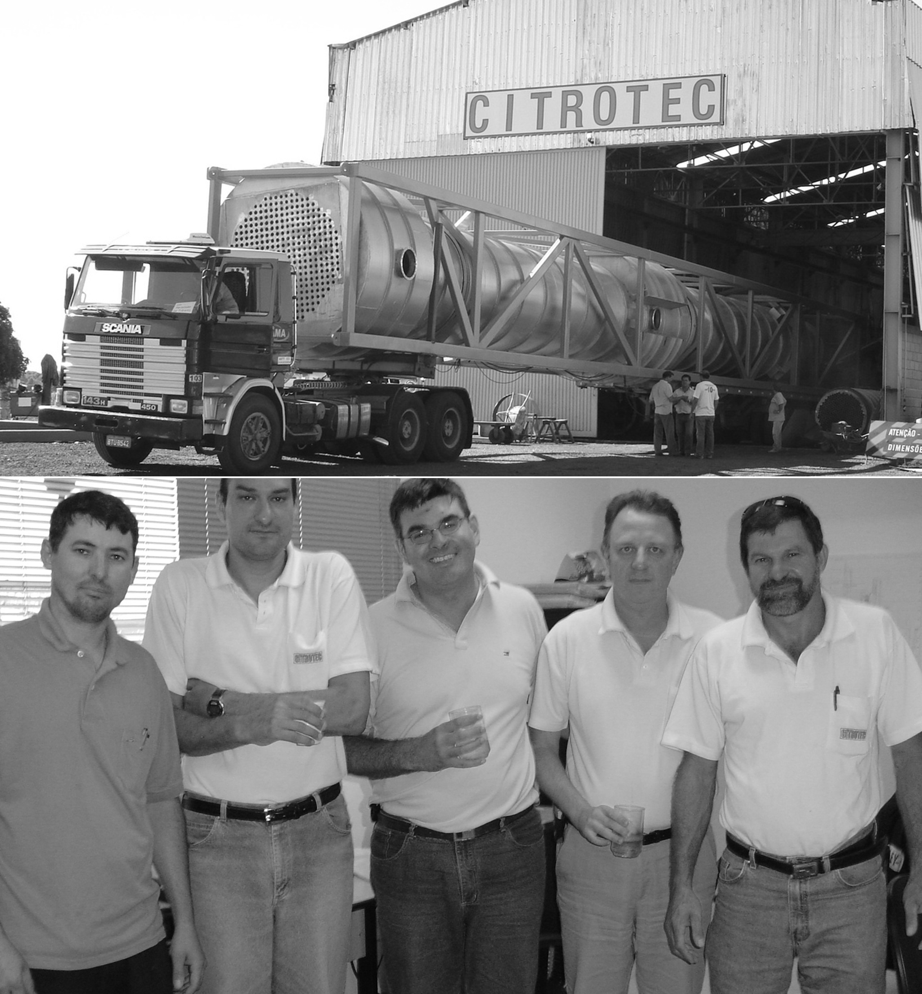

About us
Founded in 2000, Citrotec® was born in the citrus industry, evolving from a maintenance operation with five employees into a leading manufacturer of high-tech industrial equipment with more than 400 professionals.
Today, Citrotec is one of Brazil’s top suppliers to the Food & Beverage including citrus processing, and sugar-alcohol industries, petroleum and mine. With global operations across the U.S., Mexico, Europe and Africa, our growth is driven by innovation and a steadfast commitment to industrial excellence.
Engineering company delivering customized process equipment and turnkey solutions across multiple industries
More than 200 evaporation systems installed
Our portfolio includes more than 100 loyal customers worldwide

Slide 3
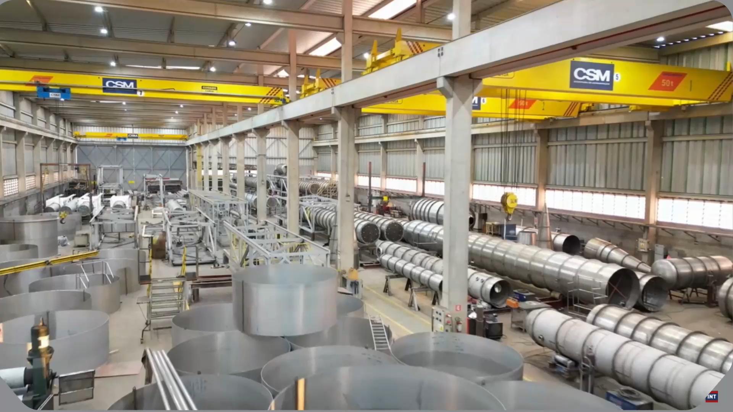
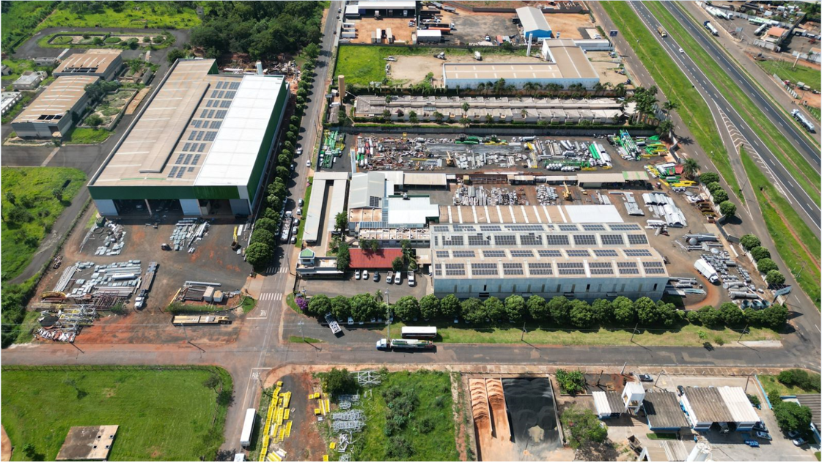
Manufacture Infrastructure
Total Site Area: 40.000 m²
Manufacturing Area: 13.000 m²
Over 400 Professionals
Overhead cranes up to 50 Tons
ASME, National Board, and ISO 9001 certified

Slide 4

The Challenge of Pulp Pasteurizing
A pulp pasteurizer is a thermal processing system designed to ensure the microbiological safety and shelf stability of fruit pulp while preserving its natural characteristics such as flavor, color, aroma, and nutritional value.
The process consists of controlled heating followed by rapid cooling, eliminating pathogenic microorganisms and reducing enzymatic activity without degrading product quality.
Producing high-quality pulp requires precise control of defects, texture, and microbiological stability.
At the same time, processors must reduce energy consumption and operational costs while maintaining consistent product performance.

Slide 5
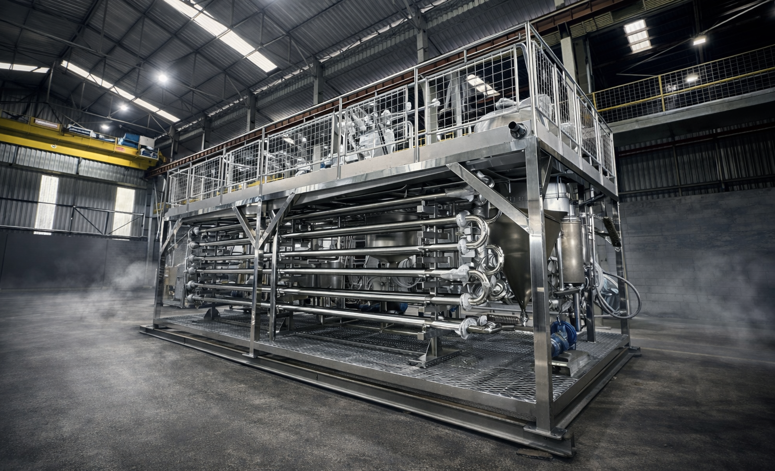
The Citrotec Solution
The Citrotec Pulp Pasteurizer is designed to ensure product safety and preserve pulp quality through controlled thermal treatment. Through controlled heating, holding, and rapid cooling, the process eliminates pathogens and minimizes product degradation, maintaining flavor, color, and nutritional value.
CITROTEC’S PREMIUM PULP PASTEURIZER BENEFITS
High Energy Efficiency
Advanced regenerative heat exchange significantly reduces steam consumption and operating costs
Superior Product Quality
Gentle and precise thermal treatment preserves taste, color, and nutrients
Reliable & Continuous Operation
Fully automated system with stable process control with fast installation, ensuring consistent industrial performance

Slide 6
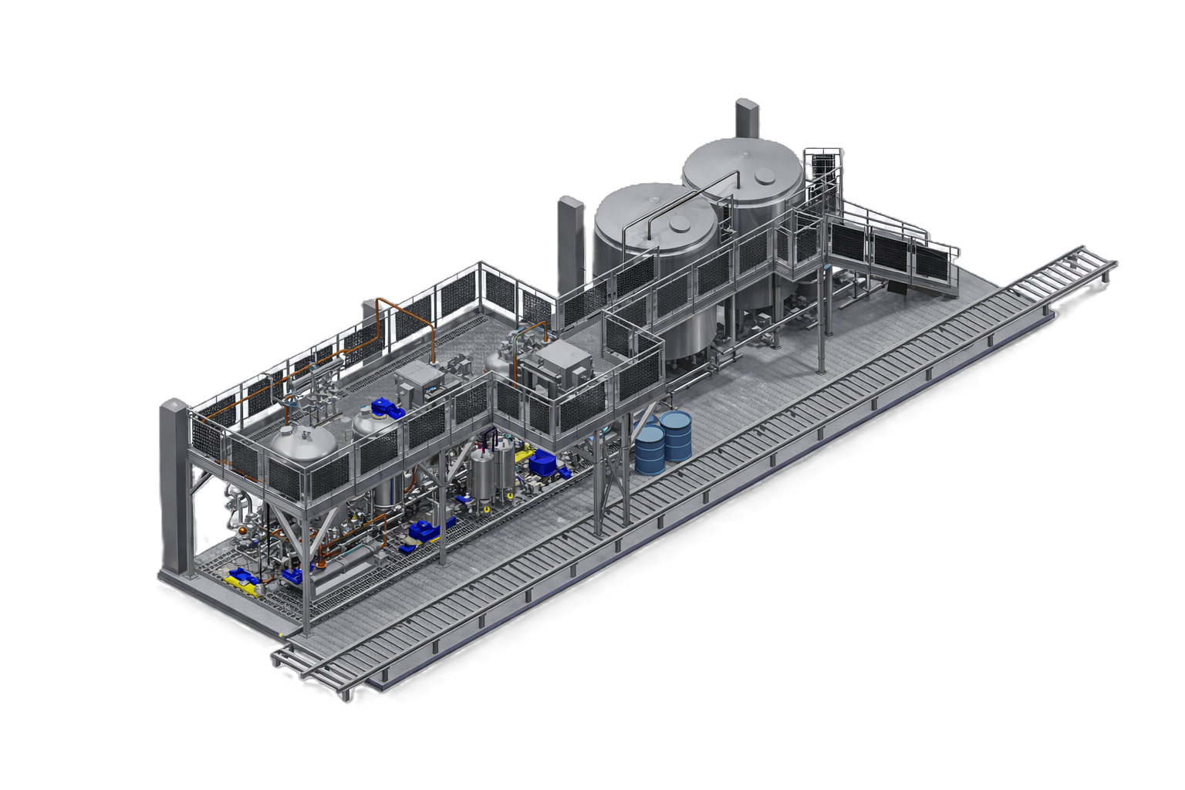
Smart Skid-Based System
The skid-mounted pulp pasteurizer is a fully integrated, factory-assembled solution designed to simplify installation and
enhance operational efficiency.
By minimizing on-site work, it significantly reduces installation time, costs, and project risks.
Its compact and modular design allows for easy integration, scalability,
and relocation, while ensuring high quality, reliability, and
optimized performance through factory testing.
The organized layout improves accessibility for
operation and maintenance, making it a practical and
efficient choice for modern processing plants.
17m
4m
*Footprint obtained from a specific case study. Consult Citrotec for more details.

Slide 7
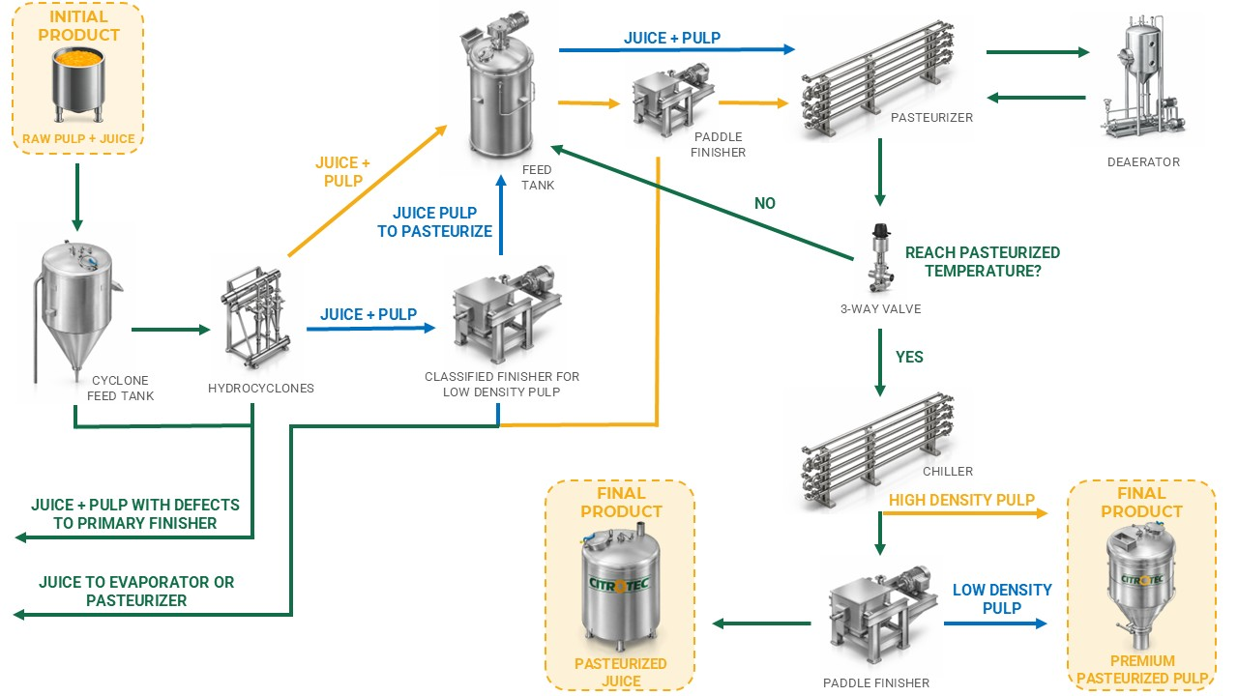

Process Overview

Slide 8
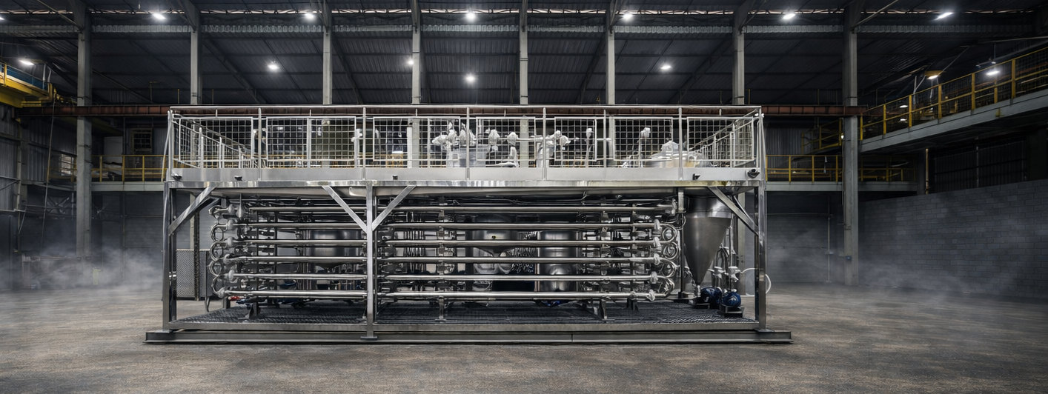
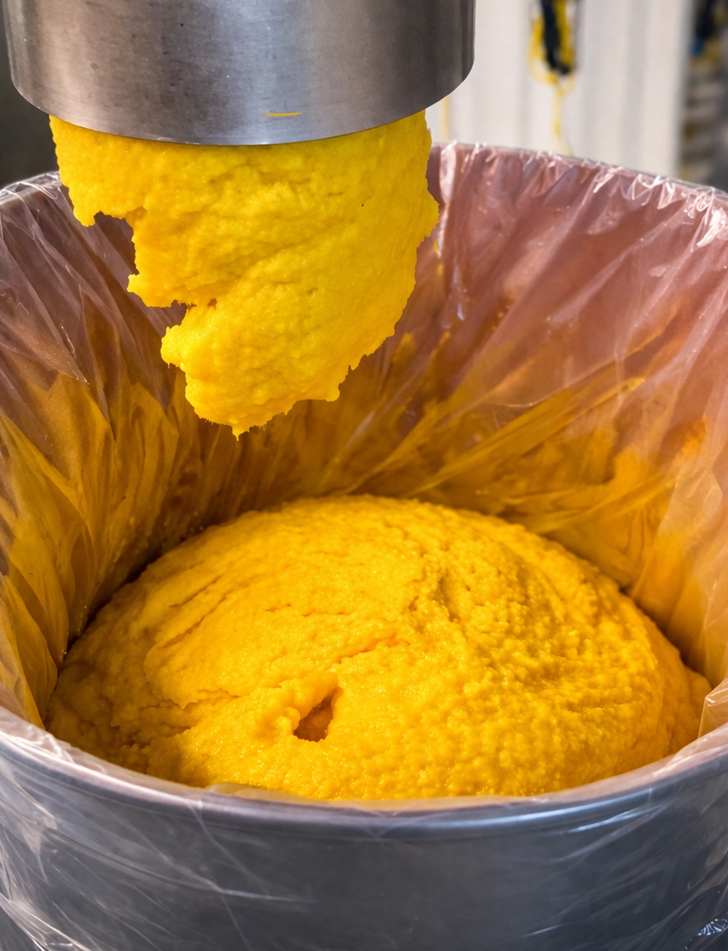




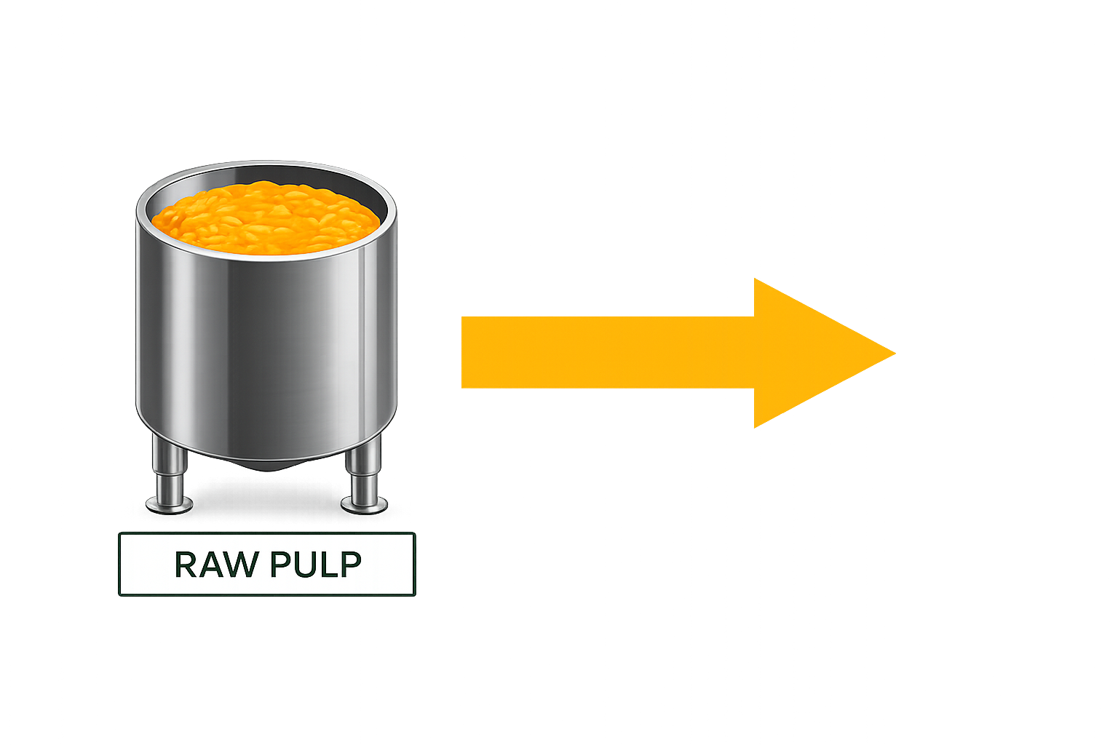

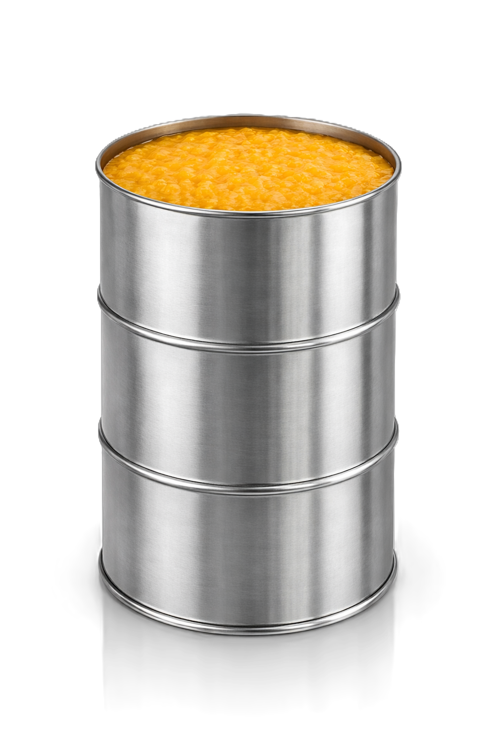
Real Industrial Application
The equipment features a multi-tube design suitable for high pulp concentration products, automated control through PLC systems, and compatibility with CIP cleaning. It is designed for continuous industrial operation with high reliability.
Citrotec pasteurization systems are successfully applied in industrial environments, demonstrating reliable performance and consistent results. The equipment is designed to meet real production demands with stability and efficiency.
*Data obtained from a specific case study. Consult Citrotec for more details.
70.5 HP
400kg/h
8 m³/h at -5°C
STEAM
+
9,000kg/h
PULP 12%
LOW PULP RAW JUICE
RETURNING TO PROCESS
7,470kg/h
765kg/h PASTEURIZED PREMIUM JUICE
765kg/h PASTEURIZED PREMIUM PULP
PASTEURIZED PREMIUM PULP

Slide 9
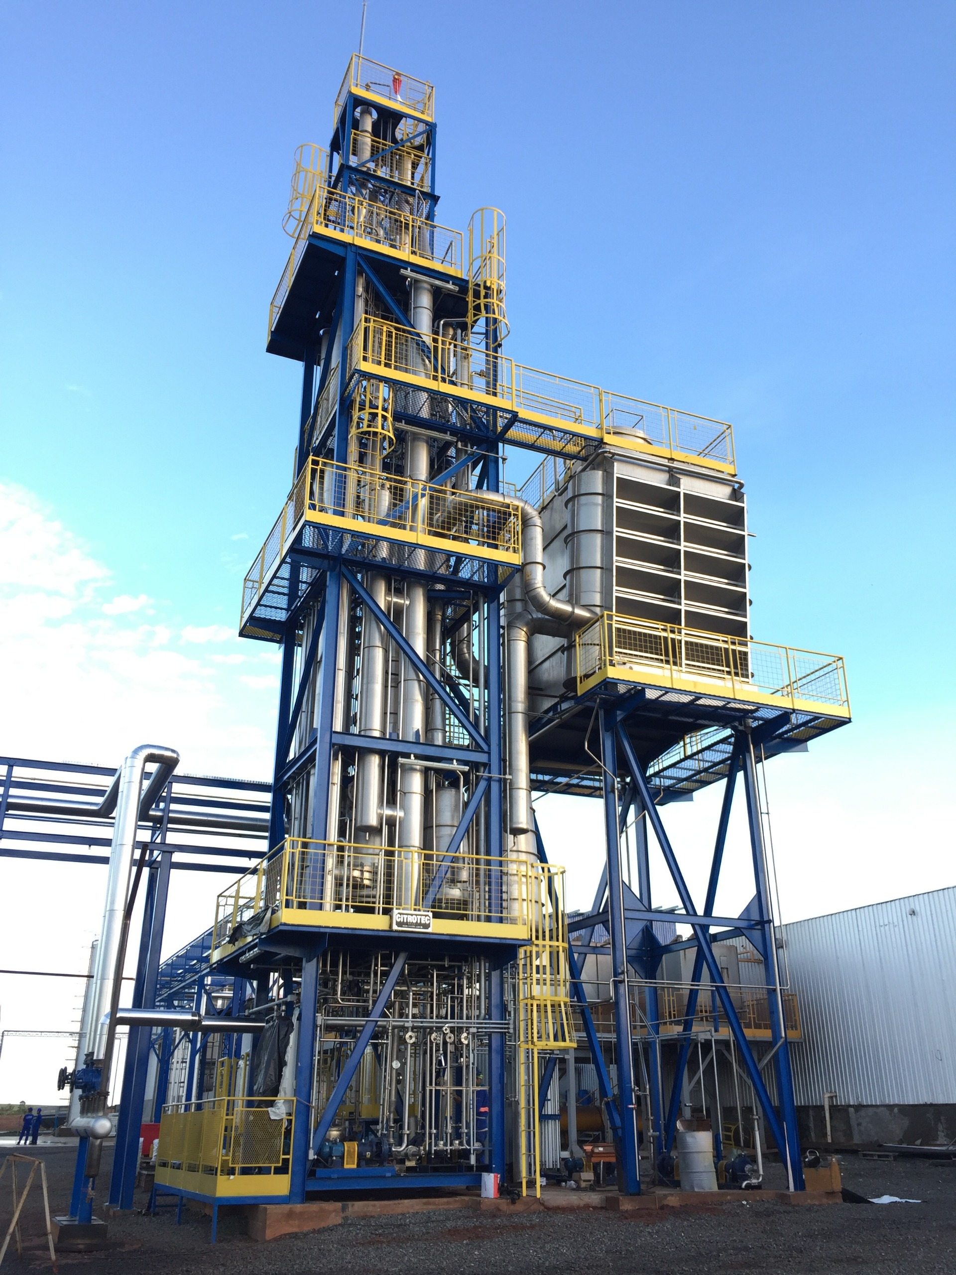
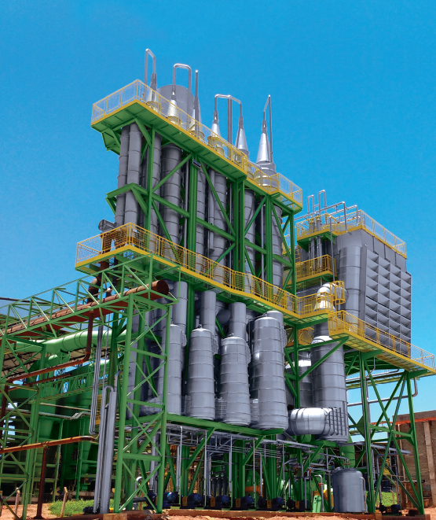
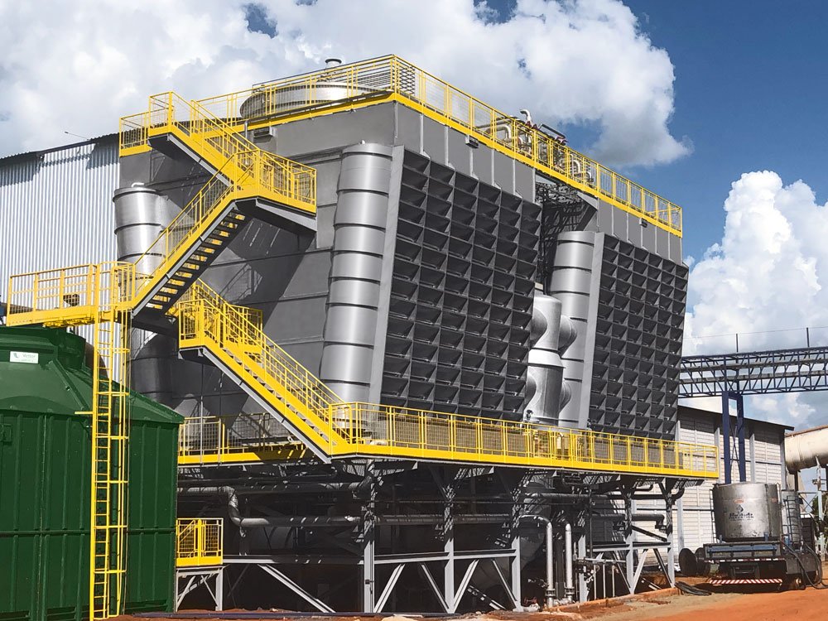

Manufacturing Excellence with Flexible Solutions
All equipments are designed and manufactured by Citrotec, following strict quality standards. The fabrication process ensures durability, precision, and compliance with industrial requirements.
Citrotec provides flexible solutions tailored to each customer’s needs. The scope can include complete systems or specific equipment, always supported by engineering expertise and process knowledge.

Slide 10





Connect with us
Marcelo Bellarde
CEO
LET’S TALK!
Phone
+1 (559) 308-2252
Our team ready to support your requirements and propose the best configuration for your application.
Email
mbellarde@citrotecinternational.com
Website
www.citrotec.com.br/en

